Slide 1


Layout Design
Micro Soft Layout

Slide 2
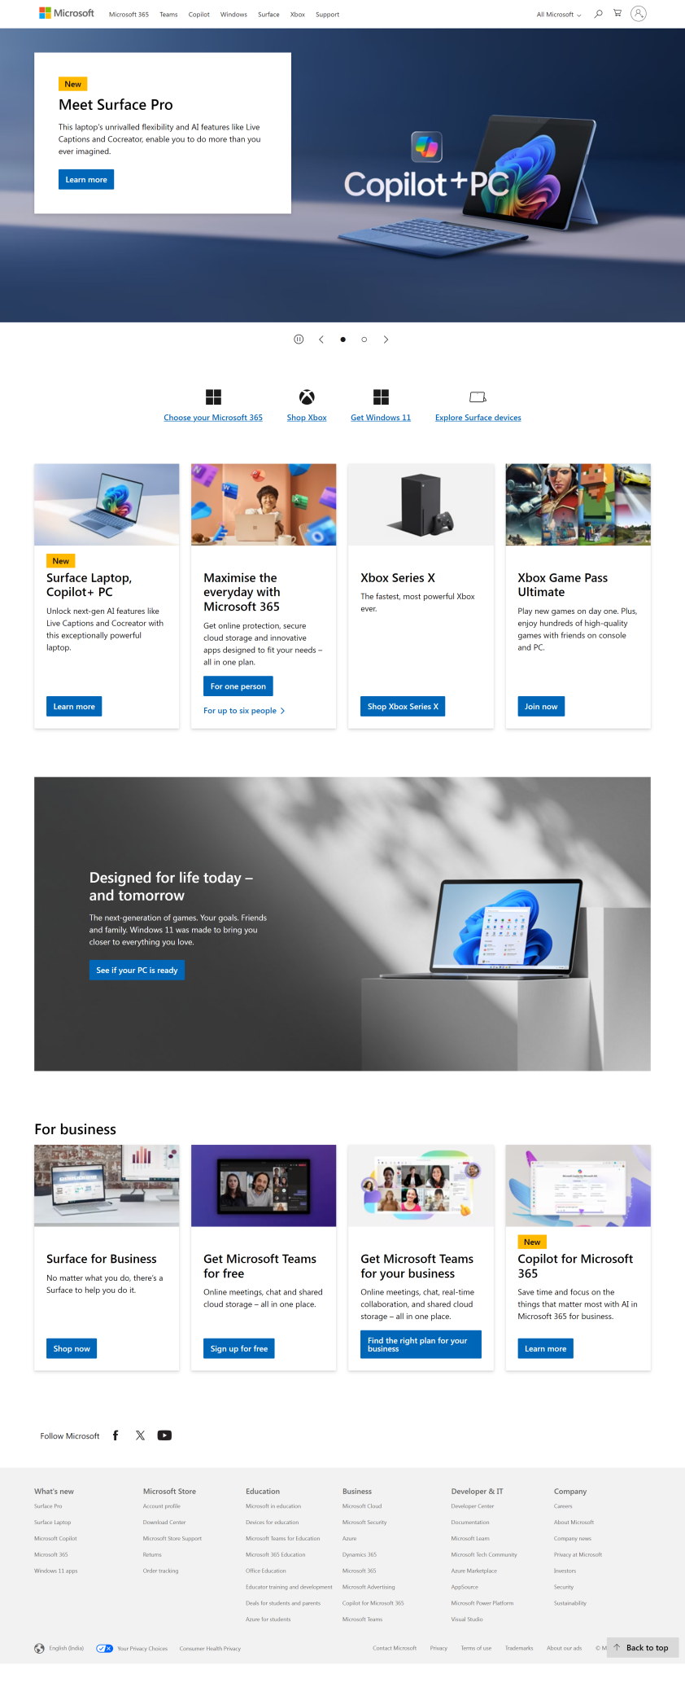
Layout Design
Containers
Total number of Containers
Parent Container for Any website
Number of Components in Coffee Shop Website
1. header
1.navBar
2. main
2.heroSection
3. footer
3.features
4.designed
5.business
6.contact

Slide 3

Layout Design
Containers
Total number of Containers
Containers
1. header
1.navBar
2.heroSection
2. main
3.features
4.designed
5.business
3. footer
8.contact

Slide 4
Layout Design
Containers
How to Group the Components to Parent Containers
1.navBar
1. header
2.heroSection
3.about
2. main
4.facility
5.menu
3. footer
8.contact

Slide 5
Layout Design
Containers
1.navBar

Slide 6
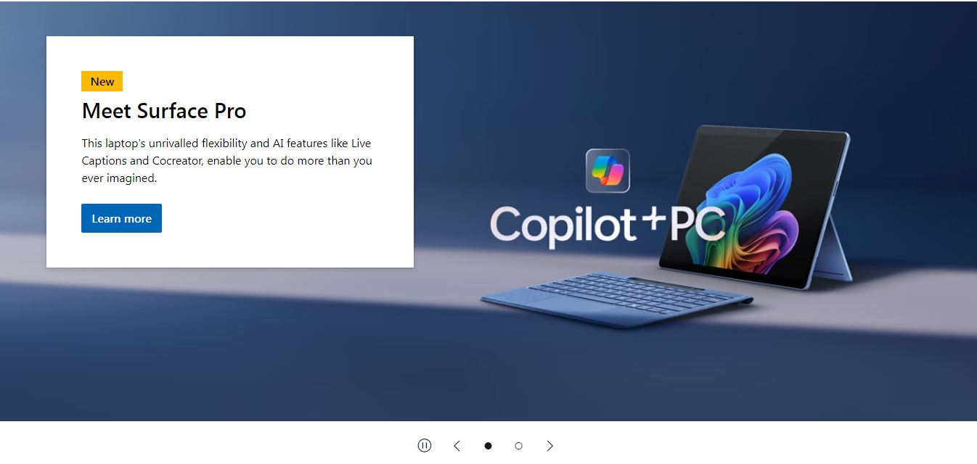
Layout Design
Containers
2.heroSection

Slide 7
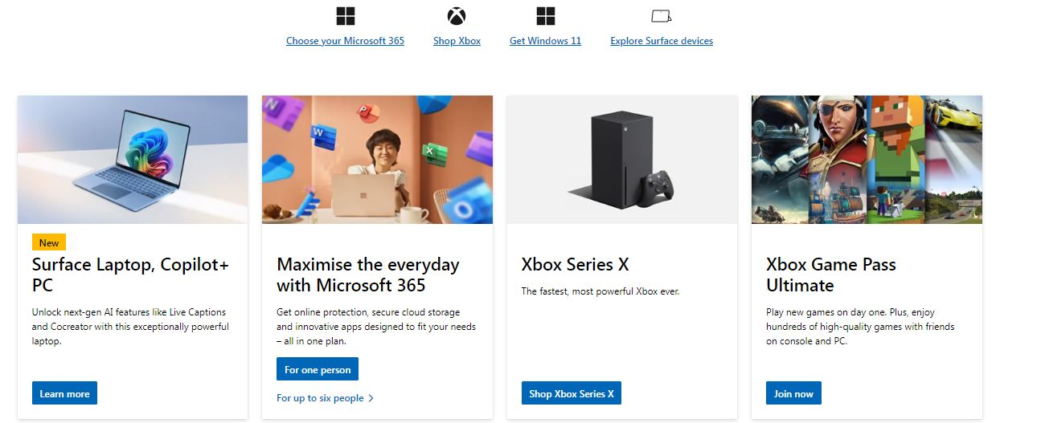
Layout Design
Containers
3.features

Slide 8
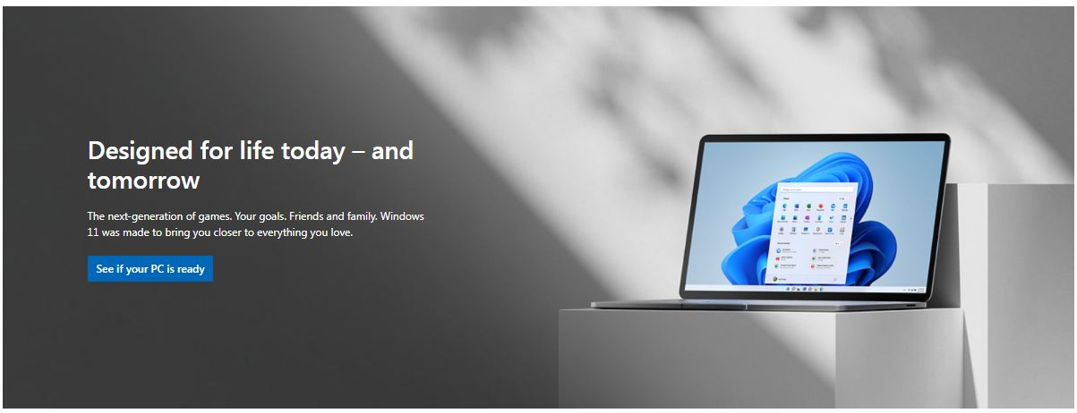
Layout Design
Containers
4.designed

Slide 9
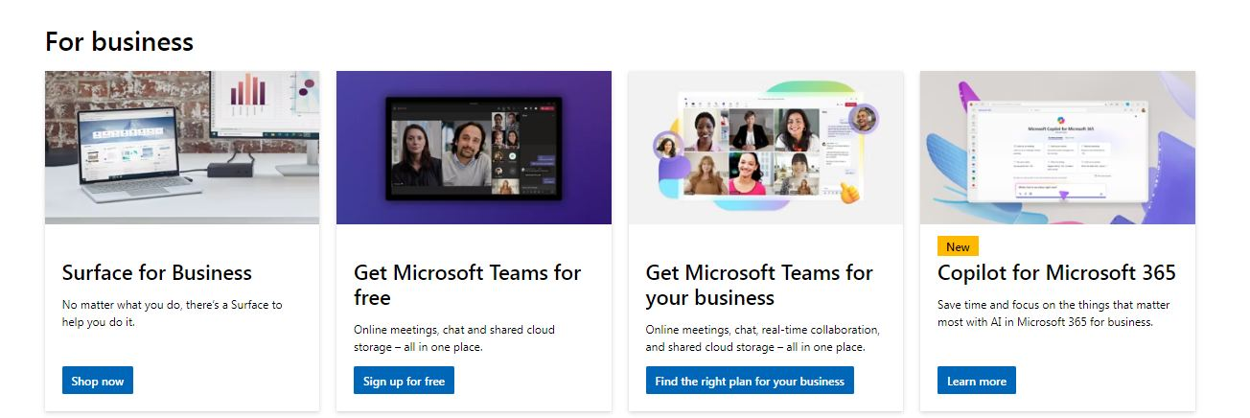
Layout Design
Containers
5.business

Slide 10
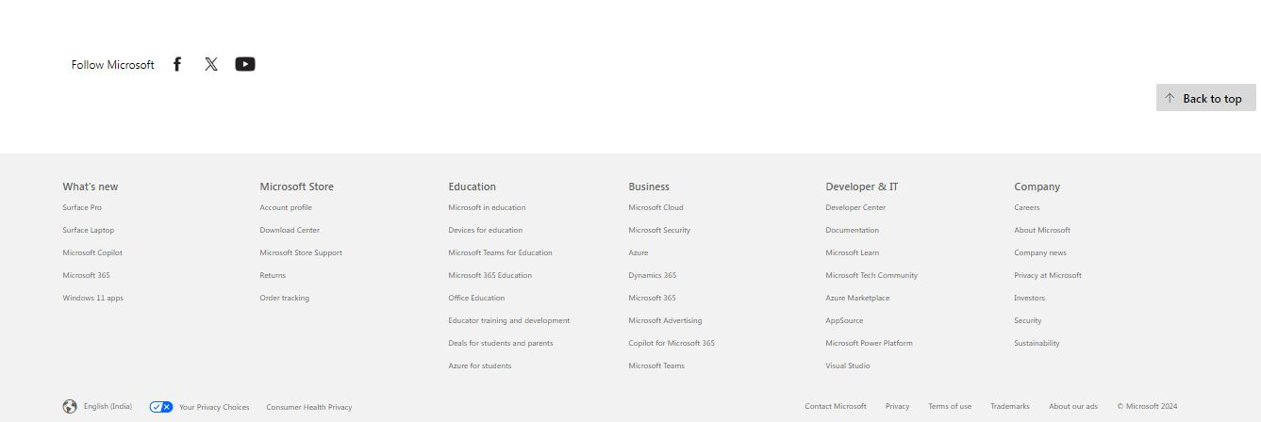
Layout Design
Containers
6.contact

